Slide 1
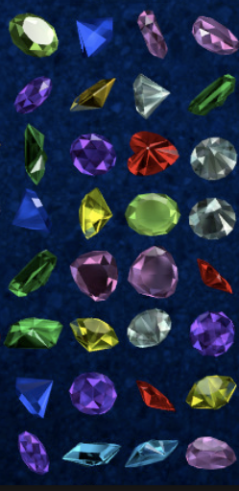
CARABAO
Building Blocks
for a
System & Process Engineering
Database Architecture
Hugo Pristauz

Slide 2
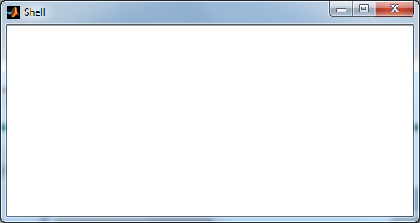
The Crystal Class
1) Inside of a Shell
2) Outside of a Shell

Slide 3
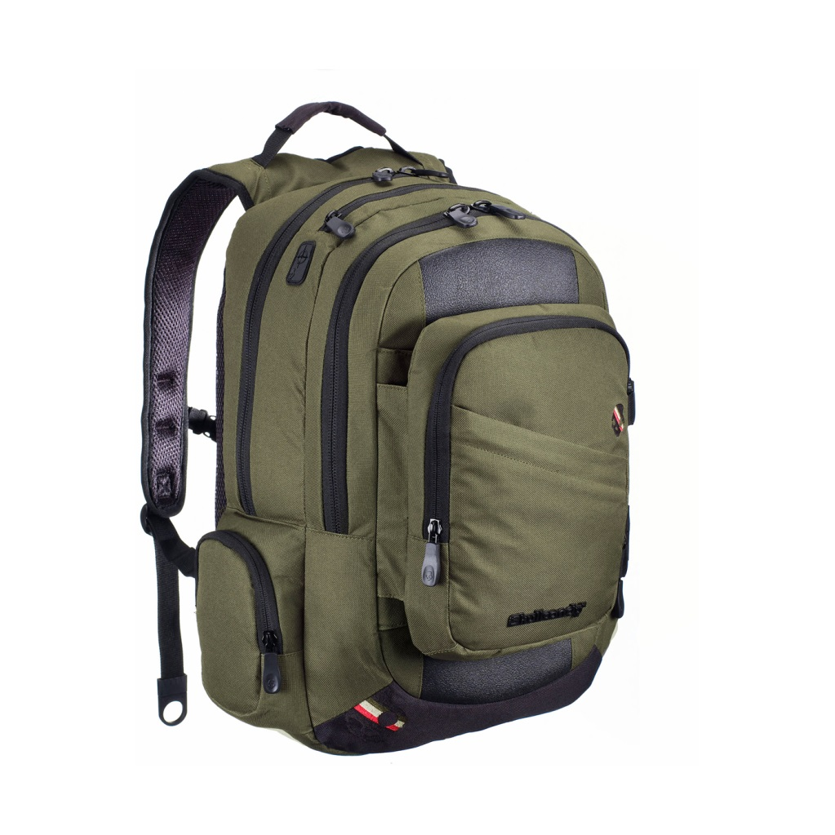
The Bag Concept
parameter
tag
get parameter property:
k = property(o, ‘par.k‘)
k = get(o, ‘k‘)
set type property:
o = property(o, ‘par.k‘, 66)
o = set(o, ‘k‘, 66)
get tag property:
typ = property(o, ‘tag‘)
set tag property:
o = property(o, ‘tag‘, ‘nucleon‘)
nucleon
data
work
get data property:
x = property(o, ‘data.x‘)
x = data(o, ‘x‘)
set data property:
o = property(o, ‘data.x‘,10)
o = set(o, ‘x‘,10)
get work property:
x = property(o, ‘work.var.x‘)
c = property(o, ‘work.opt.c‘)
u = var(o, ‘x‘)
c = opt(o, ‘c‘)
set work property:
property(o, ‘work.var.x‘,x)
property(o, ‘work.opt.c‘,c)
o = var(o, ‘x‘, x)
o = opt(o, ‘c‘, c)
type
get type property:
typ = property(o, ‘type‘)
typ = type(o)
set type property:
o = property(o, ‘type‘, ‘shell‘)
o = type(o, ‘shell‘)

Slide 4

The Bag Concept
tag
type
tag
par
data
par
data
work
type
work
bag
object

Slide 5
The Bag Concept
type
type
data
par
par
data
bag
object

Slide 6
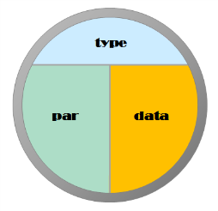
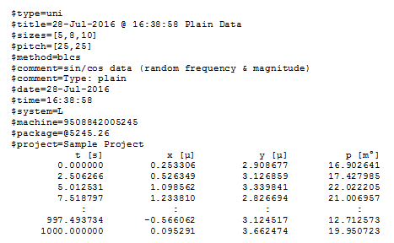
The Bag Concept

Slide 7
Syntax
parameter
logfile
header
data
parameter
identifier
=
value
identifier
[
unit
]
header
separator
identifier
[
unit
]
separator
data
datarow
separated datarow
datarow

Slide 8
Package Syntax
package
@
fourdigits
.
integer

Slide 9
Project Context
begin test
no
yes
project context
parent folder
for new package
folder is log root
parent folder
for new package
folder is current
project folder
test type
changed?
create new package
folder in proper
parent folder
perform test and log data
end test

Slide 10
Project Context
begin test
no
yes
project context
parent folder
for new package
folder is log root
parent folder
for new package
folder is current
project folder
perform test and log data
end test

Slide 11
Project Context Transition
initial
context
new project
new project
open project
new package
default
context
open project
project
context
run a test
close project
run a test

Slide 12
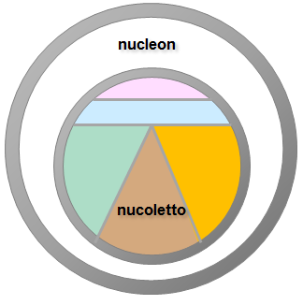
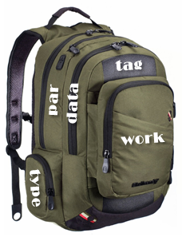
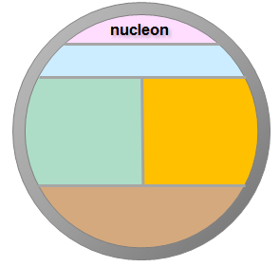
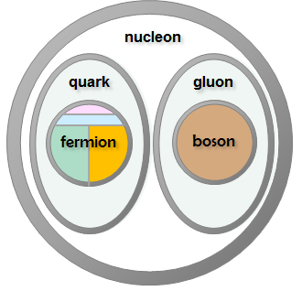
The Bag Concept

Slide 13
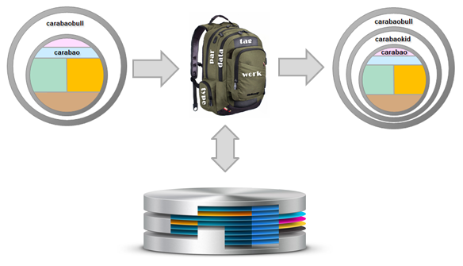
The Bag Concept

Slide 14
The Bag Concept

Slide 15
The Shell Concept
Each object instance has an assigned shell
1) >> lauch(o) % shell name is ‘shell‘
2) >> carabao(‘tiny‘) % shell name is ‘tiny‘

Slide 16
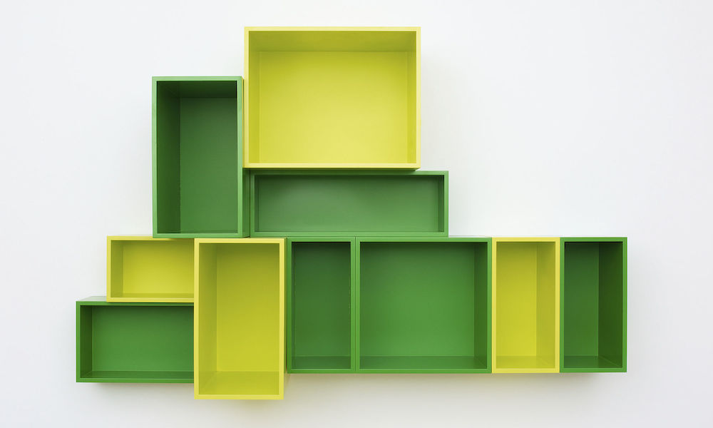
The Shelf Concept
settings
object

Slide 17
Thank You

Slide 18
The Bag Concept
nucleon
quark
gluon
tag
par
data
fermion
boson
work
type
bag

Slide 19
The Bag Concept
nucleon
tag
par
data
work
type
nucoletto
bag

Slide 20
The Bag Concept
nucleon
tag
par
data
work
type
bag

Slide 21
The Bag Concept
electron
tag
lepton
par
data
work
type
bag

Slide 22
The Bag Concept
electron
tag
lepton
par
data
work
type
bag

Slide 23
The Bag Concept
higgs
tag
par
data
work
boson
type
bag

Slide 24
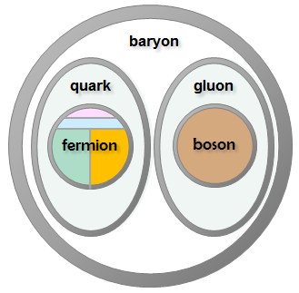
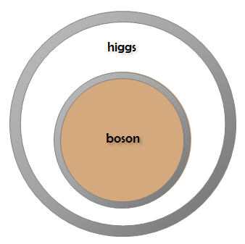
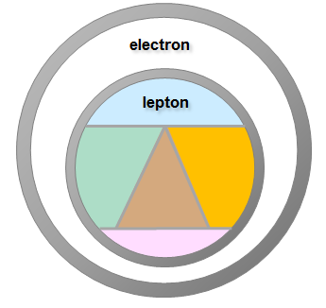
The Bag Concept

